Slide 1
Ethics in Information Technology
Unit-I

Slide 2

Ethics
Ethics is a set of beliefs about right and wrong behavior within a society

Slide 3
Difference B/W Morals ,Ethics , Laws
Morals | Ethics | Laws
One’s personal beliefs about right and wrong | Standards or codes of behavior expected of an individual by a group to which an individual belongs (nation ,organization , profession) | Law is a system of rules that tells us that we can and cannot do (nation, organization, profession)
This may vary person to person | This may vary organization to organization or group to group | This never varies as it is permanently set by the legislative bodies
Ex: One may find cheating in exams feasible , that is morally ethical but it may not be found ethical on the grounds of law and society in which you live | Ex: One may find ethically correct to not disclose the important points to other colleague , to win higher position though it may not be found morally correct | Ex: It may not be found good that if a person has found out to be guilty could be ethically incorrect but under law he/she has full right to hire a lawyer to defend himself

Slide 4
Ethics in Business World
Leadership : The conscious effort to integrate,adopt,and emulate to guide decisions and behavior of all aspects of personal life
Accountability : Holding yourself and other’s responsible for their actions, commitment towards your organization
Integrity : It means to extend to all people the same respect and consideration that you expect to receive from others. Consistency , is obviously hard to achieve, particularly when you are in a situation that conflicts with your morals .Example : when you work more than your working hours for your colleague then , you never demand for the pay but, when you work for your organization then, immediate cause for overtime pay comes in your mind

Slide 5
Respect for others: To foster ethical behavior and environments in the workplace, respecting others is a critical component. Everyone deserves dignity, privacy, equality, opportunity, compassion, and empathy.
Honesty: Honesty and commitment towards your work , bad news should also be communicated and received in the same manner as that of good news for the organization
Responsibility : Everyone should be responsible enough for the duties toward organisation and towards your co-workers
Fairness : Everyone should fair enough to give equal opportunities, and be treated the same. If a practice or behavior would make you feel uncomfortable or place personal or corporate benefit in front of equality, common courtesy, and respect, it is likely not fair.
Environmental Concerns: In a world where resources are limited, ecosystems have been damaged by past practices, and the climate is changing, it is of utmost importance to be aware of and concerned about the environmental impacts a business has. All employees should be encouraged to discover and report solutions for practices that can add to damages already done.

Slide 6
Why Business ethics?????
Gaining the goodwill of the community
Although organizations exist primarily to earn profits or provide services to customers, they also have some fundamental responsibilities to society . As a result , many organisations initiate or support socially responsible activities , which may include making contributions to charitable organisations , providing benefits for employees in excess of any legal requirements . For example : a company known for treating its employees well will find it easier to compete for the best job candidates .
Creating an Organisation That Operates Consistently
Organisations develop and abide by values to create an organisational culture and to define a consistent approach for dealing with the needs of their stakeholders i.e. shareholders, employees, customers, suppliers, and the community . Such consistency ensures that employees know what is expected of them and can employ the organisations value to help in decision making . For example: Google invested $250 million in solar and wind power projects, which depicts its one of the socially responsible activities

Slide 7
Fostering Good Business Practices
In many cases , good ethics can mean good business and improved profits. Companies provide excellent service to retain their customers instead of losing them to competitors. Suppliers and other business partners often place a priority on working with companies that operate in a fair and ethical manner. All these factors tend to increase revenue and profits while decreasing expenses. As a result , ethical companies tend to be more profitable over the long term than unethical companies . On the other hand , bad ethics can lead to bad business results. Bad ethics can have a negative impact on employees, many of whom may develop negative attitudes if they perceive a difference. When such discrepancy between employee and organization occur then, it destroys the employee commitment towards organization.
Protecting the Organization and its Employees from Legal Action
In 1909 ruling (United states v. New York Central& Hudson River Railroad Co.),the U.S Supreme Court established that an employer can be held responsible for the acts of its employees even if the employees act in a manner contrary to cooperate policy and their employer’s directions. The principle established is called Respondent Superior , or “let the master answer”

Slide 8
The CEO and the general counsel of IT solutions and services provider GSTI Corporation were forced by Small Business Administration (SBA) to resign , while three other top GSTI executives were suspended , due to allegations that GTSI employees were involved in a scheme with its contracting partners that resulted in the firm receiving money set aside for small businesses. GSTI , which had over 500 employees and revenue over $760 million , was providing services and being paid most of the fees.
Avoiding Unfavorable Publicity
The public reputation of a company strongly influences the value of its stock , how consumers regard its products and services , the degree of oversight it receives from government agencies and the amount of support and co-operation it receives from its business partners. Thus many organization are motivated to build a strong ethics program to avoid negative publicity. For example : In 2012 , Google agreed to pay a fine $22.5 million to end an FTC (Federal Trade Commission investigation into allegation that the firm utilized cookies and bypassed privacy settings to track the online habits of people using Apple’s Safari browser. Recently , also Google's Been Fined $162 Million In India for abusing its commanding position in the smartphone market.

Slide 9
Types of Business Ethics
Corporate Social Responsibility
Corporate social responsibility (CSR) is the concept of meeting the needs of stakeholders while accounting for the impact meeting those needs has on employees, the environment, society, and the community in which the business operates. Of course, finances and profits are important, but they should be secondary to the welfare of society, customers, and employees—because studies have concluded that corporate governance and ethical practices increase financial performance.
Transparency and Trustworthiness
It's essential for companies to ensure they are reporting their financial performance in a way that is transparent. This not only applies to required financial reports but all reports in general. For example, many corporations publish annual reports to their shareholders. Most of these reports outline not only the submitted reports to regulators, but how and why decisions were made

Slide 10
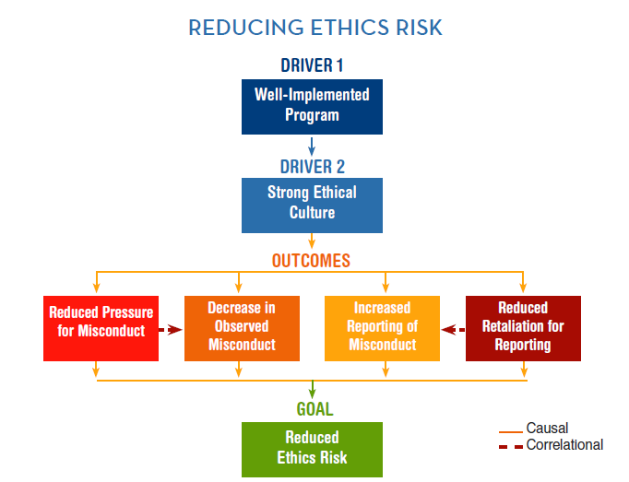

Slide 11
How an Ethical Work Environment could be created??????
1. Face the complexity involved in making ethical choices. Don’t oversimplify decisions.
Openly discuss the ethical grey areas and acknowledge the complexity of work life. Involve others in more of the ethical decisions. Be a leader who talks about the difficult ethical choices, and help others learn to take responsibility for making ethical decisions carefully.
2. Talk about the right thing to do in the context of your daily challenges. Don’t separate ethics from day-to-day business.
Make it clear to your people that ethics is “the way we operate” and not a training program or reference manual. Every activity, whether it is a training program, a client meeting, or an important top management strategy session, should include conversations about ethics.

Slide 12
3. Demonstrate respect for everyone all the time. Don’t allow negative interpersonal behaviors to erode trust.
Make respect a load-bearing beam in your culture. Be an ethical leader who expects it and practices it. Cultivate a respectful environment where people can speak up about ethics and share the responsibility for living it. Build trust, demand open communication and share the ownership of organizational values.
4. Take responsibility broadly, and reach for the highest level of ethical leadership. Don’t think about ethics as just following laws and regulations.
Take action and show consumers and other stakeholders that you are actively engaged with ethical issues that matter. Recognize how ethics influences their reasons to buy from you, and demonstrate your commitment to go beyond mere compliance with laws and regulations. Prove that you are committed to ethical issues, including human rights, social justice and sustainability.

Slide 13
5. Hold everyone accountable, and expect leaders to model the standards. Don’t exempt anyone from meeting ethical expectations.
Allow no excuses. Make sure that no one is exempted from meeting the ethical standards you adopt. Maintain the status of ethics as a total, absolute, “must do” in the organization. Hold everyone, particularly senior leaders and high profile managers, accountable. No exceptions!
6. When you talk about ethics, don’t just talk about the negative. Celebrate positive ethical moments.
Be a proactive ethical leader, championing high ethical conduct, and emphasizing prevention. Talk about what positive ethics looks like in practice as often as you talk about what to avoid. Take time to celebrate positive ethical choices.

Slide 14
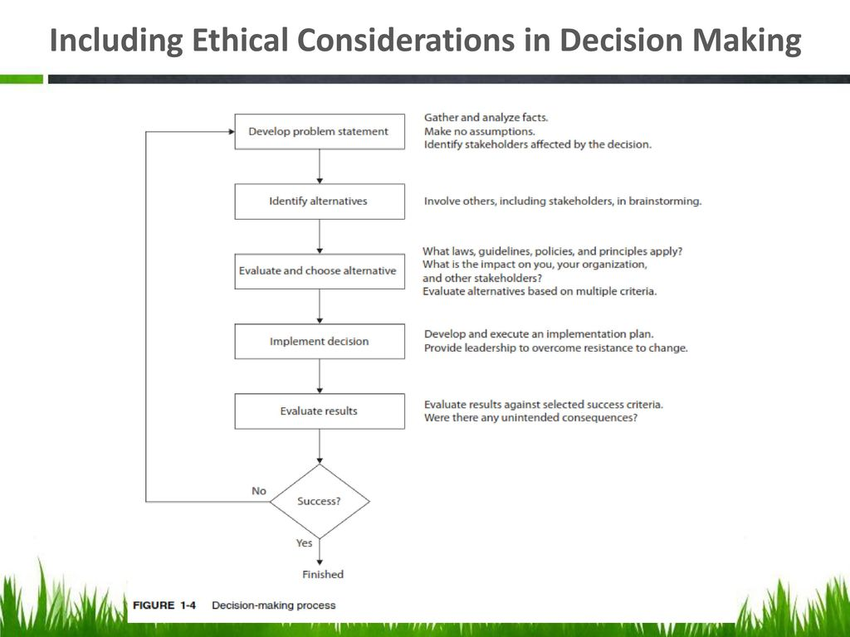

Slide 15
Ethics in IT
The growth of the internet , the ability to capture and store vast amount of personal data and greater reliance on information systems in all aspects of life have increased the risk that information technology , will be used unethically.
Examples:Many employees might have their and Internet access monitored while at work, as employers struggle to balance their need to manage important company assets and work time with employees’ desire for privacy and self-direction.
Hackers break into databases of financial and retail institutions to steal customer information, and then use it to commit identity theft—opening new accounts and charging purchases to unsuspecting victims
Web sites plant cookies or spyware on visitors’ hard drives to track their online purchases and activities.

Slide 16
Profession
A profession is a calling that requires specialized knowledge and often long and intensive preparation . The United States Code of federal regulations defines a “professional employee” as one who is engaged in the performance of work:
Requiring knowledge of an advanced type in a field of science or learning customarily acquired by a prolonged course of specialized intellectual instructions and study in an institution of higher learning
Required the consistent exercise of discretion and judgment in its performance
Which is predominantly intellectual and varied in character
Which is of such character that the output produced or the result accomplishment by such work cannot be standardized in relation to a given period of time

Slide 17
Are IT Workers Professionals?
From a legal perspective , IT workers are not recognized as professionals because they are not licensed by the state or federal government .
For a doctor to get certification requires one should be a medical school graduate pass the final MBBS examination and undergo a one-year internship in a hospital recognized by the National Medical Commission previously Medical Council Of India
For a lawyer to get certification , one needs just pass 12th and enroll in law college , register in Bar Council of India, become junior assistant ,pass ALL INDIA BAR EXAM , then work.
For This reason , in malpractice lawsuits , as many courts have ruled that IT workers are not liable for malpractice because they do not meet the legal definition of profession

Slide 18
Professional Relationship That must be Managed
IT worker
Employers
Other Professionls
IT Users
Society
Clients
Suppliers

Slide 19
Relationship between IT workers and Employers
There are many aspects which counts in building up of a relationship between IT workers and employers . The first comes with the fundamental aspects that include acceptance of job title , performance expectation, specific work responsibilities , dress code, location of employment , salary , work hours and company benefits.
Although end users often get the blame when it comes to using illegal copies of commercial software, software piracy in a corporate setting is sometimes directly traceable to IT staff members - either they allow it to happen or they actively engage in it, often to reduce IT-related spending.
Business Software Alliance (BSA):- a trade group that represents the world’s largest software and hardware manufacturers, whose mission is to stop unauthorized copying of software produced by its members. Failure to cooperate with the BSA can be extremely expensive. The cost of criminal or civil penalties to a corporation and the people involved can easily be many times more expensive than the cost of “getting legal” by acquiring the correct number of software licenses.

Slide 20
Trade secret: - information used in a business, generally unknown to the public and representing something of economic value that the company has taken strong measures to keep confidential. For example: formula of Coke, Intel’s manufacturing process for the i7quad core processing chip.
Whistle-blowing: - an effort by an employee to attract attention to a negligent, illegal, unethical, abusive, or dangerous act by a company that threatens the public interest.
For example: an employee of a chips is dangerous to employees and the general public . An employee would call the problem to management’s attention and try to correct it by working with appropriate resources within the company . But what if employee’s attempt to correct it by working with appropriate resources within channels was ignored ? The employee might then consider becoming a whistle-blower and reporting the problem to people outside the company, which may result in retaliation and firing .

Slide 21
Relationships between IT Workers and Clients
IT workers provide services to clients; sometimes those “clients” are coworkers who are part of the same organization as the IT worker. In other cases, the client is part of a different organization. Note that in relationships between IT workers and clients, each party agrees to provide something of value to the other
Typically, the client makes decisions about a project on the basis of information, alternatives, and recommendations provided by the IT worker.
Conflict of interest:- a conflict between a person’s (or firm’s) self-interest and the interests of a client. Problems can arise during a project if IT workers find themselves unable to provide full and accurate reporting of the project’s status due to a lack of information, tools, or experience needed to perform an accurate assessment
For Example: an IT consulting firm might be hired to assess a firm’s IT strategic plan.
After a few weeks of analysis , the consulting firm might provide a poor rating for
existing strategy and insist that its proprietary products and services are required to
develop a new strategic plan . Such findings would raise questions about vendor’s
recommendations should be trusted or not

Slide 22
Fraud: - the crime of obtaining goods, services, or property through deception or trickery. For example: Paul Ceglia , who in 2010 sued Facebook claiming to own a majority of the company . Ceglia claimed that he signed a contract with Mark Zukerberg in 2003 to design and develop the Website that eventually became Facebook . He alleged that he paid Zukerberg $1000 for the programming work and also invested an additional $1000 in Zukerberg’s Facebook project in exchange for 50% interest in Facebook . Ceglia manufactured evidence , including purported emails with Zukerberg , to support his false claim to an interest in Facebook . But , later it was clear to the judge that this was false evidence created recently by Ceglia and eventually he was arrested on federal mail and false charges.
Misrepresentation: - misstatement or incomplete statement of a material fact. If the misrepresentation causes the other party to enter into a contract , that party may have the legal right to cancel the contract or seek reimbursement for damages
Siri , the voice –activate software that comes with the Apple iPhone , has delighted many iPhone users ; however , not everyone has had a positive experience . Shortly, after one user realized that Siri was not performing as expected ,as it was unable to understand question and gave incorrect directions

Slide 23
Breach of contract:- when one party fails to meet the terms of a contract.
Material breach of contract:- when a party fails to perform certain express or implied obligations which impair or destroy the essence of the contract. Because there is no clear line between a minor breach and a material breach, determination is made on a case-by-case basis.” When there has been a material breach of contract , the nonbreaching party can either : →treat the contract as being in effect and sue the breaching party to recover damages
→rescind the contract , seek restitution of any compensation paid under the contract to the breaching party and be discharged from any further performance under the contract

Slide 24
Relationships between IT Workers and Suppliers
Having a good relationship with a supplier encourages the flow of useful communication. A good relationship is developed by treating suppliers fairly and not making unreasonable demands.
Suppliers strive to maintain positive relationships with their customers in order to make and increase sales. To achieve this goal, they may sometimes engage in unethical actions - for example, offering an IT worker a gift that is actually intended as a bribe.
Bribery: - providing money, property or favors to someone in business or government to obtain a business advantage. An obvious example is a software supplier sales representative who offers money to another company’s employee to get its business This type of bribe is often called as Kickback
Foreign Corrupt Practices Act (FCPA):- a federal law that makes it a crime to bribe a foreign official, a foreign political party official, or a candidate for foreign political office.
The FCPA requires corporations to have an adequate internal auditing and accounting system, and permits facilitating payments made for “routine government actions” such as obtaining permits or processing visas.
In some countries, gifts are an essential part of doing business. In fact, in some countries, it would be considered rude not to bring a present to an initial business meeting.

Slide 25
Relationships between IT Workers and Other Professionals
Professionals owe each other adherence to the professions code of conduct. Experienced professionals can also serve as mentors and help develop new members of the profession.
Résumé inflation: - lying on a résumé and claiming competence in an IT skill that is in high demand.
For Example: Yahoo! Hired a Scott Thompson, the president of eBay’s PayPal electronic payments unit , as its new CEO in January 2012 . Just after four months later, Thompson left the company , due , at least in part , to revelations that his resume falsely claimed that he had earned a bachelor’s degree in computer science
An ethical issue that can arise in relationships between IT workers and other professionals is the inappropriate sharing of corporate information.

Slide 26
Relationships between IT Workers and IT Users
Term IT user refers to a person who uses a hardware or software product; the term distinguishes end users from the IT workers who develop, install, service, and support the product.
IT workers have a duty to understand a user’s needs and capabilities and to deliver products and services that best meet those needs - subject, of course, to budget and time constraints.
Relationships between IT Workers and Society
Society expects members of a profession to provide significant benefits and to not cause harm through their actions.
It is important to note that there is currently no single, formal organization of IT workers that takes responsibility for establishing and maintaining standards that protect the public.

Slide 27
How do codes of ethics, professional organizations, certification, and licensing affect the ethical behavior of IT professionals?
Professional Codes of Ethics
A professional code of ethics states the principles and core values that are essential to the work of a particular occupational group. Practitioners in many professions subscribe to a code of ethics that governs their behavior.
An important point to make is that laws do not provide a complete guide to ethical behavior. Just because an activity is not defined as illegal does not mean it is ethical.
Professional Organizations
No IT professional organization has emerged as preeminent, so there is no universal code of ethics for IT workers. However, the existence of such organizations is useful in a field that is rapidly growing and changing.
Association for Computing Machinery (ACM)
Association for Computing Machinery (ACM), a computing society founded in 1947 with over 97,000 student and professional members in more than 100 countries. It is international in scope with an ACM Europe, ACM India, and ACM China organization.

Slide 28
Institute of Electrical and Electronics Engineers Computer Society (IEEE-CS)
Institute of Electrical and Electronics Engineers (IEEE) covers the broad fields of electrical, electronic, and information technologies and sciences. The IEEE-CS is one of the oldest and largest IT professional associations, with about 85,000 members. In 1993, the ACM and IEEE-CS formed a Joint Steering Committee for the Establishment of Software Engineering as a Profession.
Association of Information Technology Professionals (AITP)
AITP was started in Chicago in 1951 by a group of machine accountants under the name Machine Accountants Associations (MAA).
AITP provides IT-related seminars and conferences, information on IT issues, and forums for networking with other IT workers. Its mission is to provide superior leadership and education in information technology, and one of its goals is to help members make themselves more marketable within their industry.
SysAdmin, Audit, Network, Security (SANS) Institute
SANS Institute provides information security training and certification for a wide range of individuals, such as auditors, network administrators, and security managers.
2. SANS makes available, at no cost, a collection of some 1,200 research documents about various topics of information security.

Slide 29
Certification
1. Certification indicates that a professional possesses a particular set of skills, knowledge, or abilities, in the opinion of the certifying organization. Note that unlike licensing, which applies only to people and is required by law, certification can also apply to products (e.g., the Wi-Fi CERTIFIED logo assures that the product has met rigorous interoperability testing to ensure that it will work with other Wi-Fi-certified products) and is generally voluntary.
2. Certification is not a substitute for experience and does not guarantee that a person will perform well on the job. As a result, some hiring managers are rather cynical about the value of certifications.

Slide 30
Vendor Certifications
Many IT vendors - such as Cisco, IBM, Microsoft, SAP, and Oracle - offer certification programs for their products. Explain that workers who successfully complete a program can represent themselves as certified users of a manufacturer’s product. Depending on the job market and the demand for skilled workers, some certifications might substantially improve an IT worker’s salary and career prospects.
Industry Association Certifications
Point out that due to the ongoing need for strong project managers, some of the most widely recognized and most sought-after certifications come from the Project Management Institute, which offers certification at several different levels.

Slide 31
Government Licensing
Government licensing is usually handled by state governments in the U.S., and requires that the recipient pass a test.
The Case for Licensing IT Workers
As a result of the increasing importance of IT in our everyday lives, the development of reliable, effective information systems has become an area of mounting public concern. This concern has led to a debate about whether the licensing of IT workers would improve information systems
Issues Associated with Government Licensing of IT Workers
The reasons why there are few international or national licensing programs for IT professionals:
• There is no universally accepted core body of knowledge
• It is unclear who should manage the content and administration of licensing exams
• There is no administrative body to accredit professional education programs
• There is no administrative body to assess and ensure competence of individual workers

Slide 32
Common Ethical Issues for IT Users
Software Piracy
Sometimes IT users are the ones who commit software piracy. A common violation occurs when employees copy software from their work computers for use at home. The increasing popularity of the Android Smartphone operating system has created a serious software piracy problem. Some IT end users have figured out how to download applications from the Android Market Web site without paying for them and then use the software or sell it to others.
Inappropriate Use of Computing Resources
Activities such as surfing the Web, playing video games, and participating in chat rooms erode worker productivity and waste time.

Slide 33
Supporting the Ethical Practices of IT Users
The growing use of IT has increased the potential for new ethical issues and problems; thus, many organizations have recognized the need to develop policies that protect against abuses.
Establishing Guidelines for the Use of Company Software
IT managers must provide clear rules about the use of home computers and associated software, and ensure that employees have legal copies of all the software they need, regardless of the location of their work.
Defining the Appropriate Use of IT Resources
Effective guidelines allow some level of personal use while prohibiting employees from visiting objectionable Internet sites or using company email to send offensive or harassing messages.
Structuring Information Systems to Protect Data and Information
Point out that organizations must implement systems and procedures that limit data access to employees who need it

Slide 34
Installing and Maintaining a Corporate Firewall
Firewall: a hardware or software device that serves as a barrier between a company and the outside world and limits access to the company’s network

Slide 35
Q: What is meant by compliance, and how does it help promote the right behaviors and discourage undesirable ones?
Compliance
In the legal system, compliance usually refers to behavior in accordance with legislation - such the Sarbanes–Oxley Act of 2002, which established requirements for internal controls to govern the creation and documentation of accurate and complete financial statements, or HIPAA, which requires employers to ensure the security and privacy of employee healthcare data. Failure to be in conformance to specific pieces of legislation can lead to criminal or civil penalties specified in that legislation.
audit committee:- a subgroup of the board of directors that provides assistance to the board in fulfilling its responsibilities with respect to the oversight of the quality and integrity of the organization’s accounting and reporting practices and controls including: financial statements and reports; the organization’s compliance with legal and regulatory requirements; the qualifications, independence, and performance of the company’s independent auditor; and the performance of the Company’s internal audit function.

Slide 36
Main responsibilities of the internal audit department. Note that although the members of the internal audit team are not typically experts in detecting and investigating financial statement fraud, they can offer advice on how to develop and test policies and procedures that result in transactions being recorded in accordance with generally accepted accounting principles (GAAP).
• Determine that internal System and controls are adequate and effective
• Verify the existence of company assets and maintain proper safeguards over their protection
• Measure the organizations’ compliance with its own policies and procedures
• Insure that institutional policies and procedures, appropriate laws and good practices are followed
• Evaluate the adequacy of information available for management decision making

